Slide 1
The Utilization of AI Systems and Machine Learning In Traffic Management
CS 131 - Carlos Orozco

Slide 2
Contents
01
02
03
Background
Issues
Development
04
05
06
Real World
Ethics
Conclusions
A brief introduction into AI and Machine learning
The current state of Traffic management
How can AI be Used to better these systems
Implementation of AI systems into the real world
Ethical and Social Implications
A quick recap

Slide 3
Background
01

Slide 4
Background
What Is AI?
What is Machine Learning
Artificial Intelligence (AI) refers to the branch of computer science dedicated to creating systems capable of performing tasks that typically require human intelligence. These tasks include problem-solving, decision-making, understanding natural language, recognizing patterns, and adapting to new information. AI encompasses a wide range of techniques and technologies, from rule-based systems to advanced methods like neural networks and reinforcement learning. The ultimate goal of AI is to develop machines that can simulate human reasoning and behaviors to interact intelligently with their environment.
Machine Learning (ML) is a specialized subset of AI that focuses on enabling computers to learn from data and improve their performance on specific tasks without being explicitly programmed. By leveraging algorithms and statistical models, ML systems identify patterns in data and make predictions or decisions based on that information. Common applications of ML include image recognition, predictive analytics, and natural language processing. It serves as one of the most practical and widely used approaches within the broader field of AI.

Slide 5
Issues
02

Slide 6
Issues
Current Status Of Traffic Management
Los Angeles is infamous for its traffic congestion, often ranked as one of the most gridlocked cities in the world. According to US News and world report it is the 6th worst city in the U.S. in terms of traffic with the average person spending 95 hours in traffic delays and costing them $1,601 a year. The city’s sprawling urban layout, high vehicle ownership, and reliance on car-based transportation contribute to persistent delays and extended commute times. Despite having an extensive network of freeways and traffic control systems, LA's traffic management falls short due to its inability to adapt dynamically to real-time conditions. Current systems rely heavily on pre-set traffic signal timings and limited-use technologies, which struggle to accommodate unpredictable traffic patterns caused by accidents, road construction, or major events. Additionally, public transit options are underutilized, and the existing infrastructure fails to efficiently integrate alternative transportation methods, such as cycling or ride-sharing. As a result, the city faces significant economic costs, increased greenhouse gas emissions, and a lower quality of life for its residents.
https://www.usnews.com/news/cities/articles/10-cities-with-the-worst-traffic-in-the-us

Slide 7
03
Development and Use of AI

Slide 8
Development
Traffic Flow Optimization
An AI system could learn the driving patterns of a city and predict with routes are busy as well and being connected to other intersections that allow it to know where the traffic will come from. (Adaptive Stoplights)
Incident Detection
A system that integrates cameras and live feeds from first responders would be able to reroute or slow down traffic if an accident is being cleared increasing safety of the responders
AI
Public Transportation Management
Connecting the system to Public Transport would allow public transport to increase its speed and efficiency which can lead to more riders decrease the amount of cars on the road
Pedestrian Safety
An AI system could predict when high foot traffic events occur such as a school getting out and be able to slow down traffic in the areas and increasing pedestrian safety
M. I. Uddin, M. S. Alamgir, et al "AI Traffic Control System Based on Deepstream and IoT Using NVIDIA Jetson Nano," 2021 2nd International Conference on Robotics, Electrical and Signal Processing Techniques (ICREST), DHAKA, Bangladesh, 2021

Slide 9
Real World
04

Slide 10
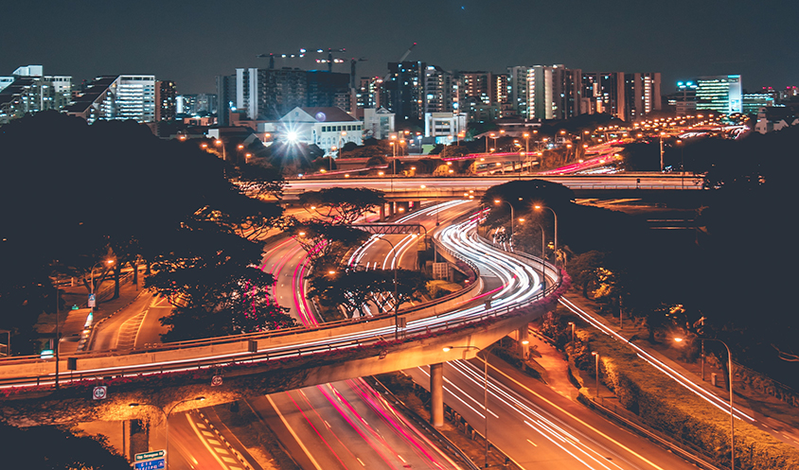
Real World
Implementation - Singapore
Singapore's Smart Traffic System leverages AI and data analytics to optimize traffic flow and reduce congestion. At its core is an Intelligent Transport System (ITS) that uses sensors, cameras, and GPS data to monitor road conditions in real time. AI algorithms analyze this data to adjust traffic signals dynamically, predict congestion, and suggest alternative routes to drivers. Additionally, the Electronic Road Pricing (ERP) system uses AI to implement congestion pricing, charging drivers more during peak hours to discourage unnecessary trips. This integrated approach not only improves travel efficiency but also promotes sustainable urban mobility by reducing emissions and encouraging the use of public transport.
https://www.mot.gov.sg/what-we-do/motoring-road-network-and-infrastructure/road-network

Slide 11
Ethics
05

Slide 12
Ethics
Privacy
Bias
The use of AI in traffic management raises important ethical and social concerns that must be carefully addressed to ensure fair and equitable implementation.
One primary issue is data privacy, as AI systems rely on extensive data collection from vehicles, smartphones, and surveillance cameras, potentially infringing on individuals’ privacy rights.
There is also the risk of algorithmic bias, where AI systems might unintentionally prioritize certain areas or demographics over others, leading to unequal access to improved traffic conditions

Slide 13
Conclusion
06

Slide 14
Conclusion
In conclusion, AI represents a transformative technology with the potential to revolutionize traffic management by addressing long-standing challenges such as congestion, inefficiency, and safety. While traditional traffic systems often fall short in adaptability and scalability, AI offers data-driven solutions that optimize traffic flow, predict patterns, and enhance public safety. Real-world applications, such as Singapore’s Smart Traffic System, demonstrate how AI can successfully integrate real-time analytics and automation to improve urban mobility. However, as we embrace these advancements, it is crucial to navigate ethical and social concerns, including data privacy, algorithmic bias, and accountability, to ensure that AI-driven traffic management systems are both equitable and effective. By balancing innovation with responsibility, AI has the potential to pave the way for smarter, more sustainable cities.

Slide 15
Sources
https://www.usnews.com/news/cities/articles/10-cities-with-the-worst-traffic-in-the-us
M. I. Uddin, M. S. Alamgir, et al "AI Traffic Control System Based on Deepstream and IoT Using NVIDIA Jetson Nano," 2021 2nd International Conference on Robotics, Electrical and Signal Processing Techniques (ICREST), DHAKA, Bangladesh, 2021
https://www.mot.gov.sg/what-we-do/motoring-road-network-and-infrastructure/road-network

Slide 16
Thanks!

